Slide 1
Natural Gas Decarbonisation Strategies and Impacts
Power Session Webinar
24 July 2024

Slide 2


Agenda and Housekeeping
Agenda
Australia’s CO2 Targets
Key Gas Sector Decarbonisation Pathways
International Best Practices
Optimizing Gas Sector Decarbonisation
Takeaways and Recommendations
Next Power Session
Housekeeping
This webinar is being recorded and distributed to all registrants along with this presentation
Add your questions to the chat. My colleague, Sara, is monitoring the queue for the Q&A session

Slide 3



Speaker – Ezra Beeman, Energeia
Ezra Beeman
Managing Director
Energeia Pty Ltd, Energeia USA, Empower Energy
Formerly, Pricing Strategy Manager for EnergyAustralia (now Ausgrid), the largest utility in Australia with 1.8 million customers serving Sydney
Empower Energy develops solar-batteries for virtual power plants, utilising Ezra’s patented battery optimisation algorithm
Master of Applied Finance, Macquarie University, Australia
Bachelor of Arts in Economics, Claremont McKenna College, United States
Bachelor of Arts in Philosophy, Claremont McKenna College, United States
energeia.au
LinkedIn.com/company/energeia-au
LinkedIn.com/in/ezra-beeman

Slide 4
Australian CO2 Pathways
State and Commonwealth
Key Strategies

Slide 5
Australia’s Federal and State CO2 Targets
Historic and Current Targets vs. Required Reduction Models
Australia has committed to increasingly ambitious reduction targets but falls below the 2°C Paris Agreement, according to Australian and independent international climate models
  Therefore, we see additional tightening as possible if the cost and risks expected by policymakers are seen as manageable
State government targets vary significantly across Australia. However, only the Australian Capital Territory (ACT) and Victoria (VIC) currently committed to a 2045 target
  Energeia’s view is that more will follow suit in the coming years
Note: 2020 datapoint is historical, TAS has already exceeded net zero target and are net negative
Source: DCCEEW (2021), State Governments, Energeia
Federal and State Net Emissions Reduction Targets
Note: 2020 datapoint is historical (excluding the Kyoto Protocol and Climate Council Authority targets)
Source: DCCEEW (2021), Climate Targets Panel (2021), Climate Change Authority (2014), Energeia

Slide 6
Australia’s Current CO2 Emissions by Sector and Fuel
Australian CO2e Emissions by Sector (2020)
Most emission in Australia are from refined products, then black coal, followed by natural gas and electricity
Natural gas is 30-40% of emissions in the mining, manufacturing and residential building sectors
Achieving state and federal carbon reduction targets will require decabonising natural gas end uses
Source: AU National GHG Accounts (2022)
Australian Energy Consumption by Type and Sector (FY21)
Source: AU Energy Update (2022)

Slide 7
Australia’s Emissions Forecasts by Sector
Australia’s Emissions Projections by Economic Sector
The top chart presents Australia’s emission projection by economic sectors in the baseline scenario
All the savings come from a reduction in utility emissions, e.g. Electricity, Gas and Water
Decarbonisation of natural gas end uses can provide a pathway to achieving state and Federal carbon reduction targets
Source: DCCEEW (2021), State Governments, Energeia

Slide 8
Key Gas Sector Decarbonisation Pathways
Clean Fuels
Thermal Energy Networks
Electrification

Slide 9
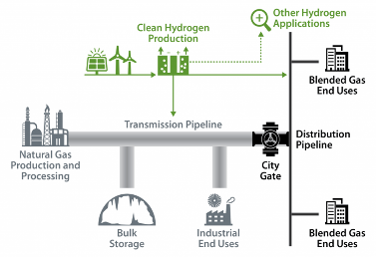
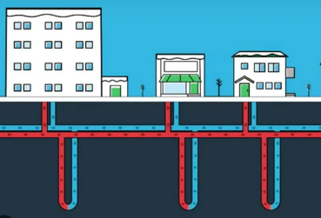

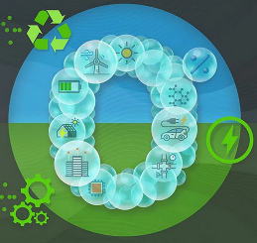
Key Gas Sector Decarbonisation Pathways
Summary of Key Pathways
Energeia’s research has identified a few key natural gas sector decarbonisation strategies
Each has their relative strengths and weaknesses, giving rise to a hybrid approach in many jurisdictions
Each of the primary pathways is discussed in greater detail in the following slides
Key Pathway | Summary | Schematic
RNG or Hydrogen Blending Pathway | Blends zero carbon, green hydrogen or Renewable Natural Gas (RNG) with natural gas (NG) in existing delivery networks Recent feasibility studies have found ~5-20% hydrogen blends can be accommodated by most existing NG networks and appliances Involves establishment of a green RNG and/or hydrogen supply chain including production, storage, and transport
Thermal Energy Network (TEN) Pathway | Uses TENs to distribute zero carbon heat generated from a geothermal network, waste heat, waterbodies, or sewer heat recovery Involves developing a new system of pipelines to deliver thermal energy, as well as installation of space, water, or industrial process heating heat pumps
End Use Electrification Pathway | Replaces fossil fuel-based appliances, equipment and systems with electric alternatives powered by renewable energy May require investment in renewable energy, grid infrastructure, and energy storage to handle increased electricity demand
Hybrid Approach | Combines hydrogen and RNG blending, TENS, and end-use electrification Can help address economic and technical limitations in RNG/hydrogen blending as well as TENs, which offers most advantage in cold climates Can enable a more flexible, lower risk, and lower cost NG sector decarbonisation pathway than any single pathway
Source: Energeia Analysis

Slide 10
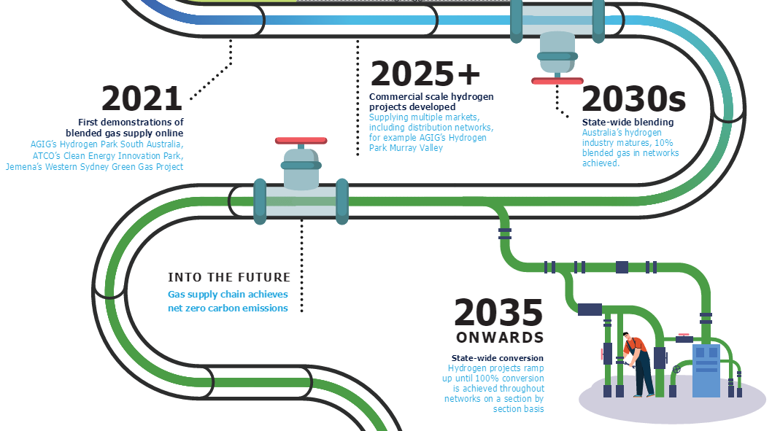
Australian Hydrogen Roadmap
Australia’s Hydrogen Blending Pathway
Natural Gas System Impacts by Hydrogen Blending Level
Limitation Area | 10% Hydrogen Blending | 100% Hydrogen Blending
Network Capacity | 2-4% reduction in network capacity | 13% reduction in network capacity
Distribution Piping | No changes required. All distribution piping in Victoria and South Australia is suitable for 10% blended gas and 100% hydrogen supply
Joint Types | No changes required | Potential replacement of some specific joints
Metal and Plastic Components | Most components are suitable for 10% and 100% hydrogen supply. Potential replacement of some specific components if further testing proves them unsuitable
Facility Piping | Stress analysis of piping layouts at each facility should be undertaken. Some field regulators may benefit from modification of pipe supports
Operational Procedures | Some potential changes should be considered; these would not be major step changes to current procedures. A list for each scenario can be found in the full State-wide reports
End Uses | Existing home appliances can work safely, reliably, and effectively | New appliances or burner parts will be required
Source: AHC
Key Capex and Opex Impacts of Blending by Design Factor
Blending Hydrogen | Reduced Capacity | Design Factor | % Increased of total cost
5% | 1-2% | 0.5 | 480%
5% | 1-2% | 0.6 | <1%
10% | 2-4% | 0.5 | 500%
10% | 2-4% | 0.6 | 68%
Source: AHC
The Australian Hydrogen Centre’s (AHC) hydrogen roadmap sees a 10% blend by the 2030s ramping to 100% on a section by section basis from 2035
Recent feasibility studies have found that blends of approximately 5-20% hydrogen can be accommodated by most natural gas networks with little increased risk, but equipment conversion needed for 20% blending
National Renewable Energy Laboratory (NREL) did Techno-Economic studies of hydrogen blending in natural gas pipelines
  The total cost of the conversion is highly dependent on the amount of hydrogen blended and the design factor of the pipeline
Notes:
The total cost of the conversion is highly dependent on the amount of hydrogen blended and the design factor of the pipeline. Note that this study does not compare against the economics of building new dedicated hydrogen pipelines but rather assumes that upgrading existing infrastructure
Design factor is a safety coefficient applied to pipeline design to account for different environmental and situational risks, ensuring the pipeline operates safely under specified conditions
Source: NREL

Slide 11
Hydrogen and RNG Fuel Costs
Current Levelised Cost of Fuel-by-Fuel Type in Australia
Renewable diesel and biodiesel are already approaching cost parity with carbon-sourced counterparts
Hydrogen prices expected to fall with input costs, but forecast price declines to date have yet to materialise
RNG prices expected to rise to bring in higher cost sources of limited supply
  Key questions include how much feedstock is available, and at what price?
Renewable diesel and biodiesel are already approaching cost parity with carbon-sourced counterparts
Hydrogen prices expected to fall with input costs, but forecast price declines to date have yet to materialise
RNG prices expected to rise to bring in higher cost sources of limited supply
  Key questions include how much feedstock is available, and at what price?
Source: ARENA (2021), ¹Energeia estimate using research from CSIRO, Argus, AER
Note: Drop-in fuels are green, fossil fuels are orange
Forecast Fuel Production Costs (Liquid)
Forecast Fuel Production Costs (Gas)
Source: CEFC (2021), Energeia
Note: All fuel types were forecasted forward using US price trends. Base year: 2010.
Source: CEFC (2021), Energeia
Note: All fuel types were forecasted forward using US price trends. Base Year: 2010.

Slide 12
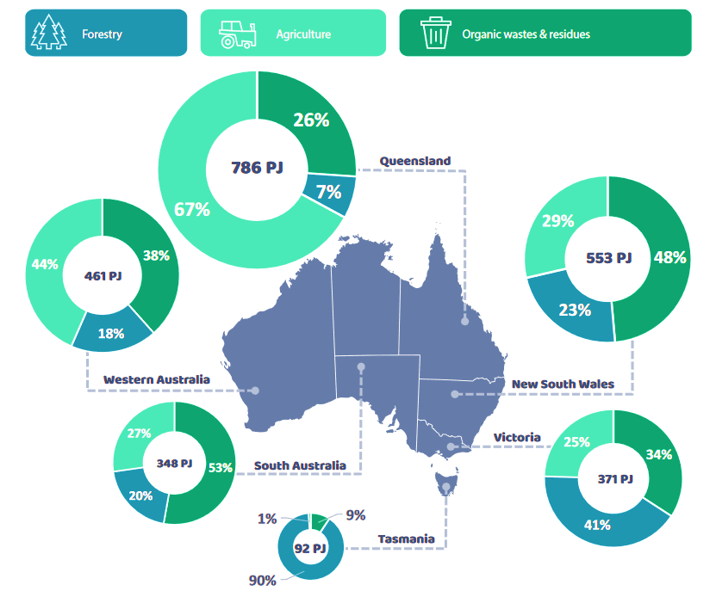
Potential RNG Feedstock Production by Type and State
Potential Bioenergy Production By Feedstock and State
Australia’s bioenergy potential is estimated to be over 2,600 PJ per year, which would represent
  40% of Australia’s current energy supply
  10 times its current bioenergy production
ARENA’s BaU scenario assumed that only 45% of the bioenergy potential could be accessed
  This amounts to ~20% of current energy supply
Organic wastes and residues are the largest resource opportunity for developing the industry in the short term
  This represents 37% of Australia’s current potential
What is lacking in this analysis is a supply cost curve, so that prices can be estimates from demand and supply
Source: ARENA (2021)

Slide 13
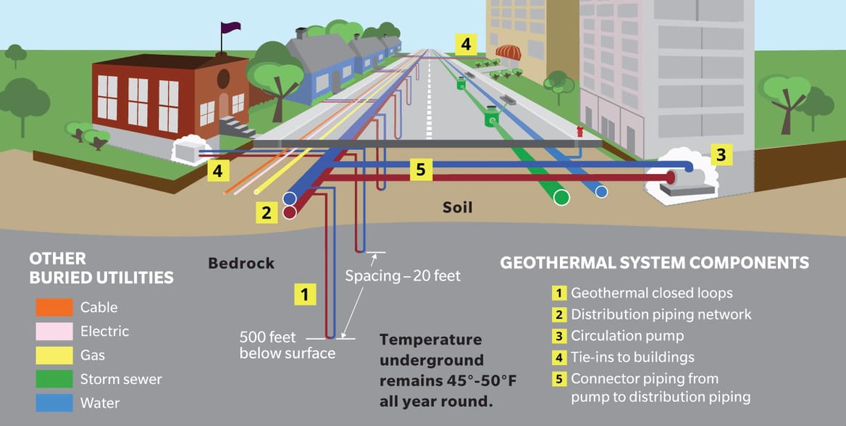
Thermal Energy Networks - 1/2
Overview of a TEN
A TENs system is shown to the left for a typical residential and commercial area
It can draw heat from a number of zero carbon sources, the most common of which are shown below left
  Pilot data shows geothermal networks to be the most common of all
Energeia’s research has found that TENS have not yet been rolled out at scale in the US
Pilot data shows a wide range of site types and both water and space heating applications
Source: Building Decarbonization Coalition (2023)
Thermal Energy Sources for TENs
TENs Pilots
Types of TENs | Description
Geothermal Networks | Shallow boreholes are used to harness the relatively constant temperature of the Earth
Direct Use Geothermal | Underground pipes are used to directly heat buildings or melt snow on roads and footpaths by heat conduction
Sewer Heat Recovery | Heat from sewer water is used for space and water heating in buildings
Waterbodies | Heating and/or cooling is extracted from nearby oceans, seas, lakes or rivers
Waste Heat without Boreholes | Heat exchangers are used to share heating and cooling between multiple buildings
Developer | Year | Location | TEN Type | Sites | Types of Sites | Types of End Uses | Funding Source
National Grid | 2024 | Lowell, Massachusetts | Geothermal Networks | 40 | Residential Commercial | Space Heating | National Grid
Eversource Energy | 2021 | Framingham, Massachusetts | Geothermal Networks | 36 | Residential Commercial | Space Heating Water Heating | Eversource Energy
Yale Acres | 2020 | Meriden, Connecticut | Geothermal Networks | 162 | Residential | Space Heating Water Heating | The Meridan Housing Authority
CO Mesa University | 2008 | Grand Junction, Colorado | Geothermal Networks | 16 | Classrooms Dormitories | Space Heating Water Heating | Colorado Energy Office
Weber State University | 2015 | Ogden, Utah | Geothermal Networks | Not found | Campus Buildings | Space Heating | Weber State University
West Union | 2012 | West Union, Iowa | Geothermal Networks | 70 | Urban Commercial | Not found | Iowa Economic Development Authority
Source: Building Decarbonization Coalition (2023)
Source: Energeia Research

Slide 14
Thermal Energy Networks - 2/2
TENs Setup and Ongoing Costs by Category
TENs costs and competitiveness with other sources of water and space heating are not widely available
Energeia has identified some published costs, but these are mainly at pilot scale, and likely to be overstated
Trial Name | Year | Sites | New or Retrofit | Customer Class | Capex ($USD/m2) | Opex ($USD/Year)
National Grid USA | 2024 | 40 | New | Mixed | $969 | Unknown
Niagara Mohawk Power Corporation | Unknown | Unknown | New | Mixed | $538 | Unknown
Buro Happold - Low Density | Unknown | Unknown | Retrofit | Residential | $178 | $2,800
Buro Happold - Medium Density | Unknown | Unknown | Retrofit | Mixed | $178 | $8,550
Source: Canstar Blue (2023, 2024), ACT Government (2023), Endeavour Energy (2024), EIA (2023), Energeia

Slide 15
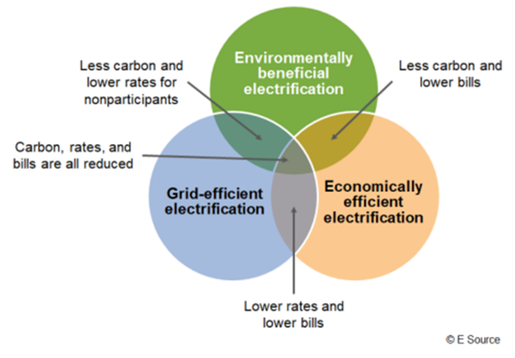
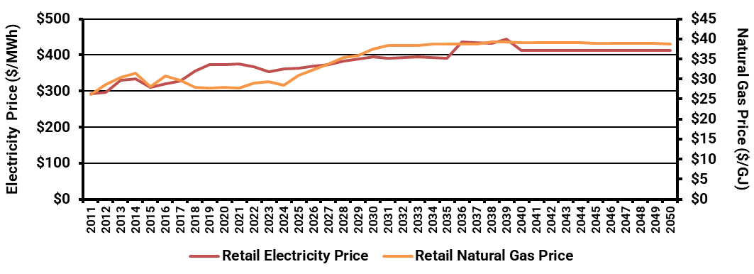
End Use Electrification
Overview of Electrification
The whole of system costs of electrifying include the impacts on the electricity wholesale market and infrastructure
  Wholesale market costs include renewable energy and firming resources such as battery storage
  Transmission costs are driven by renewable connections, while distribution costs are driven by peak demand
In Australia, gas appliances tend to be more expensive to purchase upfront but cheaper to run
  Current retail electricity prices have risen at a faster rate than retail gas prices – which may change in future
  Gas appliances are generally lower cost to purchase, and this is even more the case with heat pumps
Source: DISER (2024), IEA (2023)
Retail Energy Price Forecasts ($/GJ, $/MWh)
Source: ATCO (2023)

Slide 16
Gas Peak Demand Impacts by Sub-load on Peak Electricity Day
Winter Electricity Peak Day Load Profile
Gas demand varies significantly by state and by season
  Winter demand driven mainly by space heating
  Summer demand driven mainly by water heating and other
Example peak day load impact estimates based on wholesale gas consumption data at the total level for the given jurisdiction
Bottom right example shows different timing of a change in the peak month depending on the policy settings assumed
Source: Energeia Modelling; Note: Gas to electricity conversion assumes 100% energy conversion; Peak day is the average of the top 2.5% of peak days in Summer
Summer Electricity Peak Day Load Profile
Changes in the Timing of Peak Demand (Example)
Source: Energeia Modelling; Note: Gas to electricity conversion assumes 100% energy conversion; Peak day is the average of the top 2.5% of peak days in Winter
Source: Energeia Analysis

Slide 17
International Best Practices
Targeting, Prioritisation and Piloting
Removing Key Consumer Barriers
Tariff Design and Cost Allocation

Slide 18
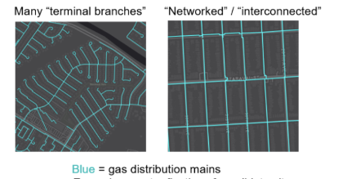
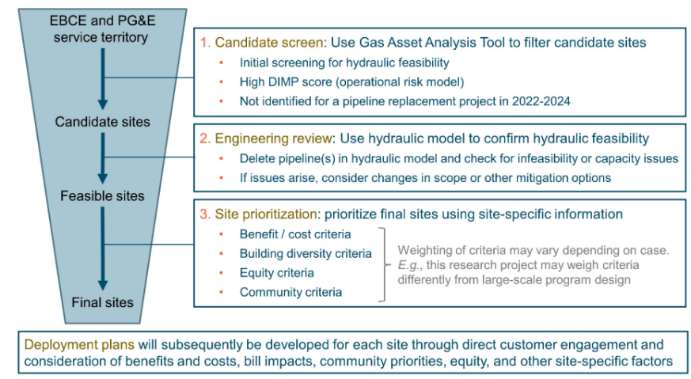
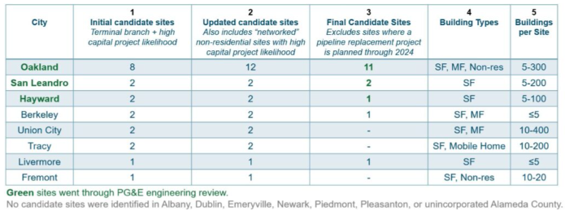
International Best Practices – Targeting, Prioritization & Piloting
Targeting Least Cost Elements (Spurs)
Top left shows a zoomed in view of distribution main gas pipeline topologies
  ‘Spurs’ in the left example, provide lower risk, lower cost decommissioning opportunities vs. ‘networked’ areas
In addition to targeting an appropriate technical granularity and type of network grid element, key economic criteria are used
  Gas consumption
  Planned (avoidable) capex
This prioritisation system is then tested via a series of pilots, such as those listed in the table below
Source: Gridworks (2022)
Targeting Criteria
Piloting
Source: Gridworks (2022)
Source: Gridworks (2023)

Slide 19
International Best Practices – Removing Key Consumer Barriers
Consumer Barriers Identified in Desktop Research and Interviews
From our research and interviews, we found that customers are primarily concerned with high upfront costs
Our interviews also identified:
  Customers are concerned with quality over health benefits
  100 amp panel upgrades are sometimes necessary
  Installation cost and time are difficult barriers for low income consumers
  Financing can be an issue for low income consumers
Based on the above, Energeia has identified key strategies for addressing key barriers
  Focus on upfront costs most important
  Streamlining, turnkey service, and spares address inconvenience barrier
  Education also key as addresses multitude of barriers
Financial Incentive
Education
Education
Education
Promotion
Concierge | Database
Concierge | Streamlining | Spares
On-Bill Financing
Concierge | Streamlining
Education
Concierge | Streamlining | Spares
Education
Education
Workforce Development
Source: Energeia Research

Slide 20
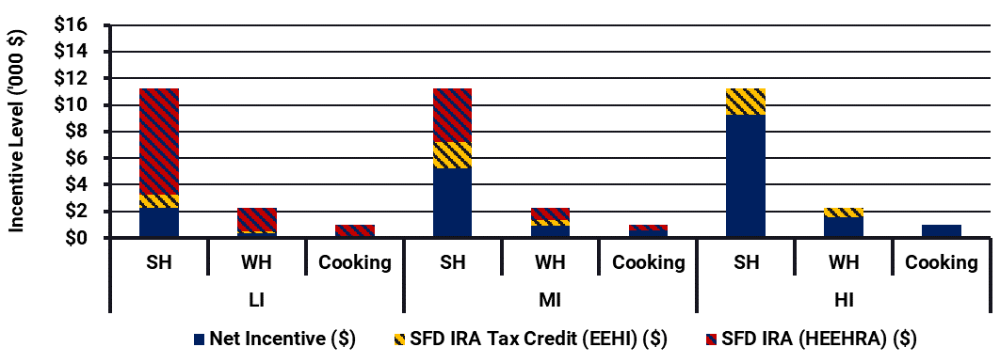
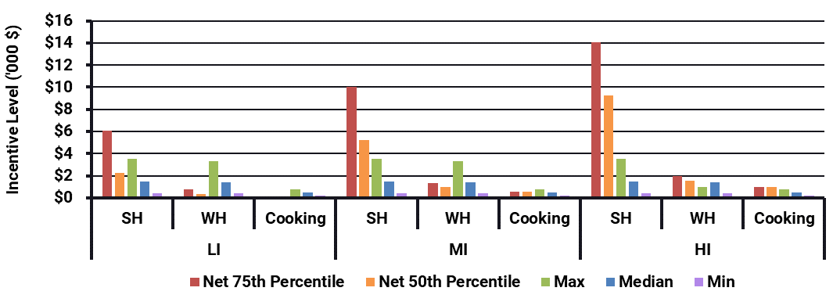
International Best Practices – Removing Upfront Barriers
Appliance Installation Premium, Net of IRA at 50th Percentile
Upfront cost premiums are being offset by estimated IRA rebates and tax credits to identify a target net differential for customers by income level and end use
  IRA tax credits assume one appliance is installed per household per year
  IRA tax credits cover 30% of net install cost (after rebates), up to $2,000
  Incentives make cooking and low-income and middle-income segments much more cost effective
It is important to also consider the distribution of cost impacts, and how best to target the incentives, e.g.
  By income
  By actual project costs
  By end use
  All of the above
Our research has found that most programs (max, median and min) are below the level needed to offset the upfront cost
  Low income incentives are the exception
Source: Energeia Research, The Switch is On
Ideally, Incentives Need to Vary with Premiums
Source: Energeia

Slide 21
International Best Practices - Tariffs and Cost Allocation
Electricity Tariff Design – California Utility Example
Recognising that steep rises in electricity prices are increasingly making electrification more costly for consumers, the CPUC recently required IOUs to implement a lower variable cost tariff
Lower variable costs are achieved by moving costs into the daily fixed charge
  $15/month charge added to the BE rate
It is worth noting that Australia’s fixed charges are already higher than these levels
Table to the left shows the five options defined by the UK Office of Gas and Electricity Markets (Ofgem) to pay for the £3bn cost
Similar discussions are being had in most other jurisdictions, but few appreciate the impact on decommissioning cost efficiency
Source: PG&E (2024)
Decommissioning Cost Allocation
Options for Ofgem | Action Defined
Government | Write-down and decommissioning costs are recouped from current and future consumers
Gas Network Investors | Ofgem highlights would this “create asset stranding risk” and “likely not be in the consumer interest”
Future Consumers | Ofgem notes that this will be a relatively small group of consumers, with many falling into ‘vulnerable’ categories
Current Consumers | Requiring an increase in network charges from 2026
Purchasers of the Networks for Repurposing | The network owners would probably claim any residual asset value to be theirs regardless of the Regulatory Asset Value (RAV) position
Source: Regen UK (2024)

Slide 22
Optimising Gas Sector Decarbonisation
Key Data Sources
Targeting, Timing and Duration
Costs and Cost Allocation
Customer Behavior
Cross-Sector Issues

Slide 23
Key Decommissioning Optimisation Data Sources
Key Gas Decommissioning Costs and Data Sources
Developing an optimal decommissioning strategy requires access to a range of data, ideally spatially integrated
The table to the left identifies a range of key data needed to optimise gas sector decarbonization, and the expected source
  While some key data is available in the public domain, such as the Regulatory Asset Base (RAB), it may not be broken out in sufficient detail to link to highly granular prioritisation analysis
  It is important to note that hydraulic modeling is a key factor in the efficient decommissioning of gas networks, and the inputs to this type of modeling are only held by gas utilities
Not all gas utilities will keep granular data on their assets, but in general, the industry’s asset management data is improving
In Energeia’s experience the most difficult data to collect is:
  Gas network decommissioning costs – Decommissioning gas pipelines is highly variable in cost and there are currently many unknowns in the space of gas network decommissioning
  Gas network infrastructure data – Only very general information (e.g. total pipeline length) is publicly available. GIS pipeline data is only obtainable through the system operator
  Hydraulic modelling data – Needed to determine feasibility of decommissioning portions of the network, this data is only obtainable through the system operator and requires specialist engineering knowledge to use
Category | Sub-Category | Main Drivers | Cost or Benefit Compared to No Shutdown | Available
Electricity Network | Electricity Network Peak Demand Costs | Network Incremental Demand | Cost | 1, 2
Gas Network | Gas Network Maintenance Costs | Gas Network Repex and Opex Costs | Benefit | 1, 2
 | Gas Network Shutdown Costs | Gas Network RAB Recovery and Decommissioning Costs | Cost | 1, 2
Energy Retailers | Wholesale Electricity Costs | Electricity Consumption and Wholesale Price | Cost | 1
 | Wholesale Gas Costs | Gas Consumption and Wholesale Price | Benefit | 1
Energy Consumers | Appliance Replacement Costs | Appliances Replaced Before End of Economic Life | Cost | 1, 3
Government | Government Program Costs | Level of Electrification Incentive | Cost | 3
Wider Community | CO2e Emissions Costs | Reduction in CO2e Emissions | Benefit | 1
Note: 1 = Public Domain, 2 = Utility Held, and 3 = Neither

Slide 24
Gas System Targeting, Timing and Duration
Key Shutdown Optimisation Criteria
Energeia has modeled shutdown at the suburb or state level due to data limitations
Energeia has modelled two main shutdown methods:
  Phased approach – Shutting down an equal number of suburbs by year starting from the suburbs with the least gas consumption
  Threshold approach – Shutting down suburbs when they reached an assumed percentage (20% assumed here) of 2023 consumption
Importantly, the threshold approach can lead to rapid shutdowns, in part due to consumer defection
  The impact on deliverability and cost are important to know
Criteria Category | Description
Hydraulic Feasibility | Initial screening and hydraulic modelling to confirm hydraulic feasibility
Benefit and Cost Criteria | Gas system avoided costs and electricity distribution system costs
Usage Criteria | Gas usage criteria, which drives the cost per term, for a given section
Equity Criteria | Impact on disadvantaged communities (DAC)
Source: Energeia Research
Illustrative Threshold Shutdown
Illustrative Phased Shutdown
Source: Energeia Modelling
Source: Energeia Modelling

Slide 25
Gas System Decommissioning and Write-down Costs
Normalised Decommissioning Costs
Decommissioning costs in the public domain vary widely, reflecting less experience but also differences in territories
Illustrative outcomes from each of the key cost allocation methods is shown below
These results show how taxpayer funded methods keep prices down, avoiding mass consumer defection as costs rise
This can help minimise consumer gas appliance and industry gas asset write-down costs – at least until policy requires it
Source | Jurisdiction | Normalised Decommissioning Cost (AUD/km)
Frontier (2016): Future Regulation of the UK Gas Grid | United Kingdom | $79,178
ICF (2016): Decommissioning Methodology and Cost Evaluation | Virginia, United States | $99,163 - $264,436
EvoEnergy (2023) | Australian Capital Territory, Australia | $30,682
Source: Energeia Research
Summary of Cost Allocation Options
Illustrative Impact of Cost Allocation Options on Prices
Cost Allocation Options | Definition | Why they’re used | Stakeholders Most Impacted
Accelerated Cost Recovery | Current users pay a greater share of asset write-down and decommissioning costs | Spreads costs more equitably between current and future consumers, potentially more efficient | Current Gas Customers
Taxpayer Funded | Taxpayers fund the cost of the decommissioning and asset write-downs | Reduces price impacts to push out the death spiral, potentially resulting more efficient, equitable outcome | Taxpayers
Recovery as Incurred | Asset write-down and decommissioning costs are recovered when they are incurred | User pays, though it can potentially impact vulnerable consumers more and be less efficient | Remaining Gas Customers
Source: Energeia
Source: Energeia Modelling

Slide 26





Electricity Sector Impacts
Impacts on Peak Demand Timing
These graphs illustrate the potential impact by scenario over time on electricity peak demand timing
Also shown is the potential impact of a change in peak demand timing on the contribution of transport electrification
  This is due to shifting peak into when more charging occurs
Below right shows a range of potential peak demand mitigation options, depending on the electricity system conditions
Source: Energeia Modelling
Impacts on Transport Coincidence
Options for Electricity System Impact Mitigation
Low Temp
Heat Pump
Water Heating
Heat Pump
Schneider Wallbox
Electric Vehicle Charger
Tesla PowerWall 2
Battery
LG Solar Panels
Source: Energeia Modelling
Source: Energeia Research

Slide 27
Takeaways and Recommendations

Slide 28
Takeaways and Recommendations
Takeaways
  As the 4th largest source of CO2 emissions by fuel type, decarbonising Australia’s gas consumption is essential
  Electrification is one option, but there are other options as well, including green hydrogen and other clean fuels, and TENs
  A hybrid approach appears to be most common approach currently, enabling technology to develop
  Electrification can deliver full decarbonization of the natural gas system, but comes at a cost, including gas asset write-downs, decommissioning costs
  Optimising these costs requires a whole of system (including electricity and gas) approach
  Data availability is often limited, but needed to identify the optimal pathway
  Key considerations include timing, duration, and segmentation of the gas system, as well as bans, incentives and cost allocation
  Significant decommissioning and write-down costs, including customer appliances, may favour pushing out these costs
Recommendations
  Take a wide view of potential pathways to decarbonising the natural gas system, including TENs and clean fuels
  Investigate costs for emerging technologies like TENs and zero carbon fuels, and potentially invest in their R&D to bring costs down
  More data is essential to making the best possible decisions
  When optimizing the decarbonization pathway, it is essential to take a whole of system approach, including customer appliance costs
  Cost allocation is a key policy decision to be made, due to the feedback loops involved and recovery of costs from fewer users and usage

Slide 29

Energeia
Power Sessions
Q & A
Next Power Session Topic

Slide 30




Energeia’s Power Sessions
Q&A
  Add your questions in the chat
  Unanswered questions will be answered via email
Vote for your favorite Power Session webinar topic
  Best Practice Distribution Grid Resilience Using Microgrids
  Hydrogen Cost Drivers and Least Cost Pathways
  How to Design Fit for Purpose System Modeling Scenarios
  Estimating V2x Impacts on Premises, Markets, and Grid
  Developing Standard Grid Services for Virtual Power Plants
Where to find Energeia and Ezra Beeman
  Website
    Energeia.au
    Energeia-USA.com
  LinkedIn
    Energeia
    Energeia USA
  Email
    insights@energeia.com.au
    ebeeman@energeia.com.au
Watch for a follow-up email with recording and presentation links to share
Reserve your place at the next Power Session discussion
Unpacking Unprecedented
Peak Demand Forecasting
24 Sep 2024
9:30 AM – 10:00 (AEST)

Slide 31
Thank You!

